Slide 1
Sapiens Decision Admin - Settings
Eyal Livne – May 2016

Slide 2








Search
23
John
⌃
Admin
Admin
Communities
Glossaries
Security
Settings
Utilities
BCR Type
Deployment
Environment Mgmt.
External Provider
Message Categories
Proxy Type
Users
Views
Workflows
Business Concept
Custom properties
Domain Template
Qualifiers
Model Mapping
View Fact Types
Permission Groups
Roles
Users
Custom Properties
Data Type Formats
File Extensions
Format Definitions
Functions
Operators
Verbs
Repository Definitions
System Options
Test Groups Format Definition
Batch Job
Deployment Adaptor Regression Tool (DART)
Import / Export Control
Monitoring
Upload file
Workflow Analysis

Slide 3
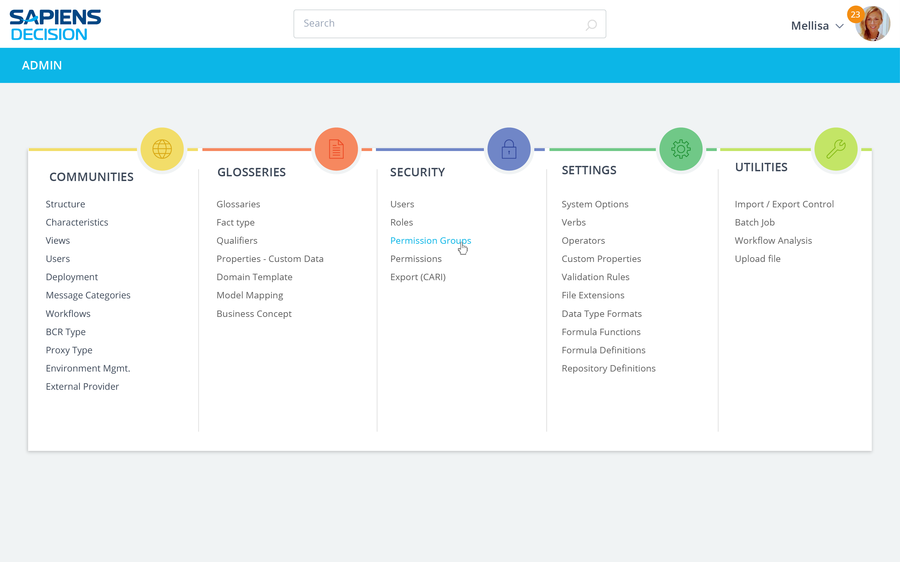


Admin
COMMUNITIES
GLOSSARIES
SECURITY
SETTINGS
UTILITIES
BCR Type
Deployment
Environment Mgmt.
External Provider
Message Categories
Proxy Type
Users
Views
Workflows
Business Concept
Custom properties
Domain Template
Glossaries Tree
Qualifiers
Model Mapping
View Fact Types
Permission Groups
Roles
Users
Custom Properties
Data Type Formats
File Extensions
Format Definitions
Functions
Operators
Verbs
Repository Definitions
System Options
Test Groups Format Definition
Batch Job
Deployment Adaptor Regression Tool (DART)
Import / Export Control
Monitoring
Upload file
Workflow Analysis

Slide 4
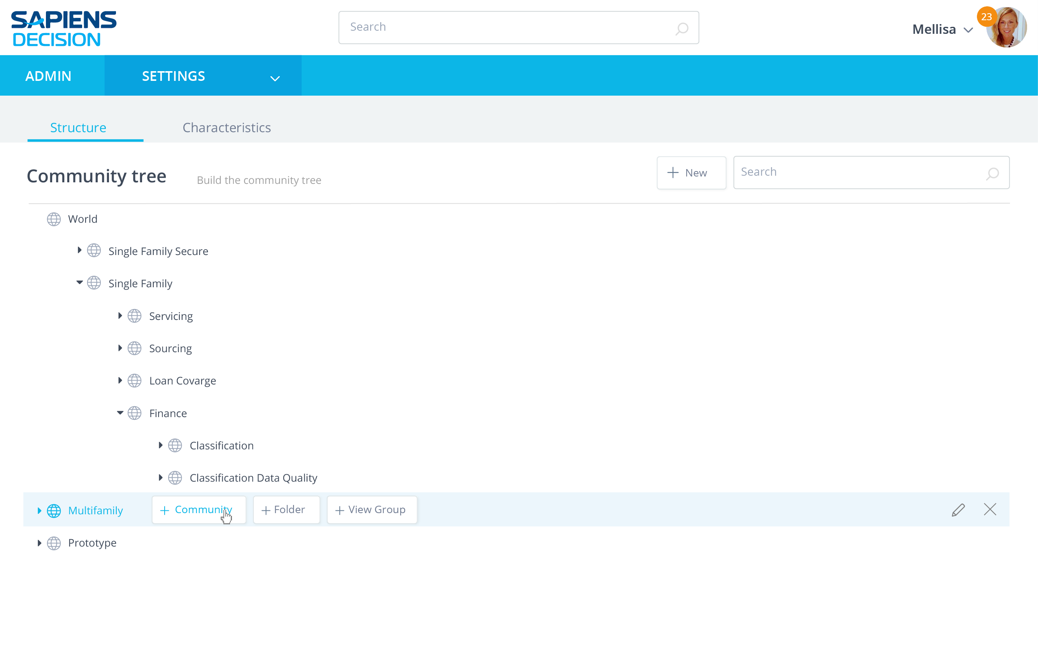


Admin > Settings
Settings
Search Settings
Custom Properties
Data Type Formats
File Extensions
Format Definitions
Functions
Operators
Repository Definitions
Test Group Formats
Validation Rules
Verbs
System Options
Manage the Custom Properties of Entity Type
Set the display format of Data Types
Rolling a row highlights it in light blue
All active elements are ‘marked’ – here, the name is a link so it becomes blue
Manage which File Extensions are supported in the BCR
Set the Environment Format Definitions’ Status
Manage or Import new functions
Change Operators’ symbol or uncheck Data Type options
Set the Repository Definitions’ Status
Set the Environment Test Groups Format Definitions’ Status
Define validations a Warning or as an Error
View or Add Decision Views verbs
Set the system and layout options

Slide 5
Admin > Settings
Settings
Search Settings
Custom Properties
Data Type Formats
File Extensions
Format Definitions
Functions
Operators
Repository Definitions
Test Group Formats
Validation Rules
Verbs
System Options
Manage the Custom Properties of Entity Type
Set the display format of Data Types
Hovering the link adds the underline
Click to go to the ‘Custom Properties’ page
Manage which File Extensions are supported in the BCR
Set the Environment Format Definitions’ Status
Manage or Import new functions
Change Operators’ symbol or uncheck Data Type options
Set the Repository Definitions’ Status
Set the Environment Test Groups Format Definitions’ Status
Define validations a Warning or as an Error
View or Add Decision Views verbs
Set the system and layout options

Slide 6
Custom Properties
Data Type Formats
File Extensions
Format Definitions
Functions
Operators
Repository Definitions
Test Group Formats
Validation Rules
Verbs
System Options
Custom Properties

Slide 7
Admin > Settings > Custom Properties
Custom Properties
Search a Property
⌃
Name
Custom Properties
Data Type
Display Format
Allowed Values
Required
Retired
Decision Flow
Decision Flow Sub Flow
Decision Flow Task
Decision View
Nothing should be hidden
All sub-lines appear – row gets taller
If line s too long, it breaks line and appears as well
Property A
Implementation Notes
Owner
Source
TEXT
TEXT
TEXT
TEXT
Text
Text
Text
Text
Any Value
Any Value
Any Value
Any Value
Fact Type
Project
Revision/Tag
Rule Family View
ATB1
ATB2
TEXT
TEXT
Text
Text
Any Value
Any Value
Project Mandatory Template 1
Project Template 2
TEXT
TEXT
Text
Text
Any Value
Any Value
Required
Revision Mandatory Property 1
Revision Template 2
TEXT
TEXT
Text
Text
Any Value
Any Value
Required
Financial Significant
FS Effective Date
note
TEXT
TEXT
TEXT
Any Value
Any Value
Any Value
Rule Family View Role

Slide 8
Admin > Settings > Custom Properties
Custom Properties
Search a Property
⌃
Name
Custom Properties
Data Type
Display Format
Allowed Values
Required
Retired
Decision Flow
Decision Flow Sub Flow
Decision Flow Task
Decision View
Hovering the row highlights the entire height of the row
Links behave as defined
Property A
Implementation Notes
Owner
Source
TEXT
TEXT
TEXT
TEXT
Text
Text
Text
Text
Any Value
Any Value
Any Value
Any Value
Fact Type
Project
Revision/Tag
Rule Family View
ATB1
ATB2
TEXT
TEXT
Text
Text
Any Value
Any Value
Project Mandatory Template 1
Project Template 2
TEXT
TEXT
Text
Text
Any Value
Any Value
Required
Revision Mandatory Property 1
Revision Template 2
TEXT
TEXT
Text
Text
Any Value
Any Value
Required
Financial Significant
FS Effective Date
note
TEXT
TEXT
TEXT
Any Value
Any Value
Any Value
Rule Family View Role

Slide 9
Admin > Settings > Custom Properties > Decision View
Decision View
Add
Search a Decision View
✕
Order
Custom Properties
Data Type
Display Format
Allowed Value
Required
Retired
1
2
3
4
Property A
Implementation Notes
Owner
Source
TEXT
TEXT
TEXT
TEXT
Text
Text
Text
Text
Any Value
Any Value
Required
Retired
Values appear only when they are active – retired or required

Slide 10

Admin > Settings > Custom Properties > Decision View
Decision View
Add
Search a Decision View
✕
Order
Custom Properties
Data Type
Display Format
Allowed Value
Required
Retired
✕
1
2
3
4
Property A
Implementation Notes
Owner
Source
TEXT
TEXT
TEXT
TEXT
Text
Text
Text
Text
Any Value
Any Value
Drag row element added on hover as well
Hovering a row adds the ‘remove row’ [X] symbol when it’s possible

Slide 11
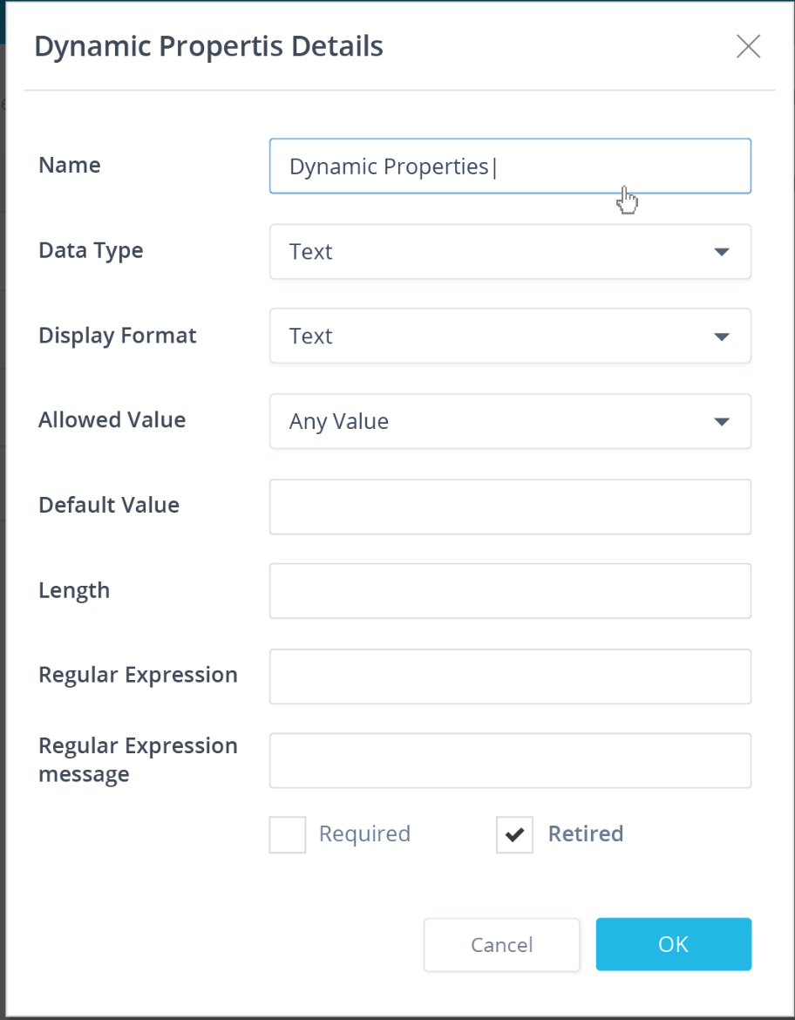
Admin > Settings > Custom properties > Decision VIew
Decision View (4)
Add
Search a Deployment
✕
Dialog with “Any Value”
Order
Custom Properties
Data Type
Display Format
Allowed Value
Required
Retired
✕
1
2
3
4
Dynamic Properties
Implementation Notes
Owner
Source
TEXT
TEXT
TEXT
TEXT
Text
Text
Text
Text
Any Value
Any Value

Slide 12
Custom Properties Details
✕
Admin > Settings > Custom properties > Decision VIew
Name
Dynamic Properties
Decision View (4)
⌃
Add
Search a Deployment
Data Type
TEXT
✕
Display Format
⌃
Order
Custom Properties
Data Type
Text
Display Format
Allowed Value
Required
Retired
Dialog with “Set”
One value filled in
See interactions on the next page
Allowed Value
⌃
✕
1
2
3
4
Dynamic Properties
Implementation Notes
Owner
Source
TEXT
TEXT
TEXT
TEXT
Set
Text
Text
Text
Text
Any Value
Any Value
Values
Import
value1
Add
✕
Default Value
Length
Regular Expression
Regular Expression message
Required
Retired
Cancel
OK

Slide 13
Custom Properties Details
✕
Custom Properties Details
✕
Admin > Settings > Custom properties > Decision VIew
Name
Dynamic Properties
Name
Dynamic Properties
Decision View (4)
⌃
Add
Search a Deployment
Data Type
✕
⌃
TEXT
Data Type
TEXT
Display Format
⌃
Display Format
⌃
Order
Custom Properties
Data Type
Text
Text
Display Format
Allowed Value
Required
Retired
Interactions for the dialog with “Set”
One value filled in
Allowed Value
⌃
Allowed Value
⌃
✕
1
2
3
4
Dynamic Properties
Implementation Notes
Owner
Source
TEXT
TEXT
TEXT
TEXT
Set
Set
Text
Text
Text
Text
Any Value
Any Value
Values
Import
Values
Import
value1
✕
value1
value1
Add
Add
✕
✕
Default Value
Default Value
Length
Length
Regular Expression
Regular Expression
Regular Expression message
Regular Expression message
Required
Retired
Required
Retired
Cancel
OK
Cancel
OK

Slide 14
Custom Properties Details
✕
Custom Properties Details
✕
Admin > Settings > Custom properties > Decision VIew
Name
Dynamic Properties
Name
Dynamic Properties
Decision View (4)
⌃
Add
Search a Deployment
Data Type
TEXT
Data Type
✕
⌃
TEXT
Display Format
⌃
Display Format
⌃
Order
Custom Properties
Data Type
Text
Text
Display Format
Allowed Value
Required
Retired
Dialog with “Range”
One value filled in
See interactions on the next page
Allowed Value
⌃
Allowed Value
⌃
✕
1
2
3
4
Dynamic Properties
Implementation Notes
Owner
Source
TEXT
TEXT
TEXT
TEXT
Range
Range
Text
Text
Text
Text
Any Value
Any Value
From
To
From
To
✕
value1
value2
value1
value1
value2
value1
value2
Add
Add
✕
✕
Default Value
Default Value
Length
Length
Regular Expression
Regular Expression
Regular Expression message
Regular Expression message
Required
Retired
Required
Retired
Cancel
OK
Cancel
OK

Slide 15
Admin > Settings > Custom properties > Decision View
Decision View
Add
Search a Decision View
✕
Order
Custom Properties
Data Type
Display Format
Allowed Value
Required
Retired
1
2
3
4
Property A
Implementation Notes
Owner
Source
TEXT
TEXT
TEXT
TEXT
Text
Text
Text
Text
Any Value
Any Value
Hovering the button = hover state

Slide 16
Admin > Settings > Custom properties > Decision View
Decision View
Add
Search a Decision View
✕
Order
Custom Properties
Data Type
Display Format
Allowed Value
Required
Retired
✕
1
2
3
4
Property A
Implementation Notes
Owner
Source
TEXT
TEXT
TEXT
TEXT
Text
Text
Text
Text
Any Value
Any Value

Slide 17
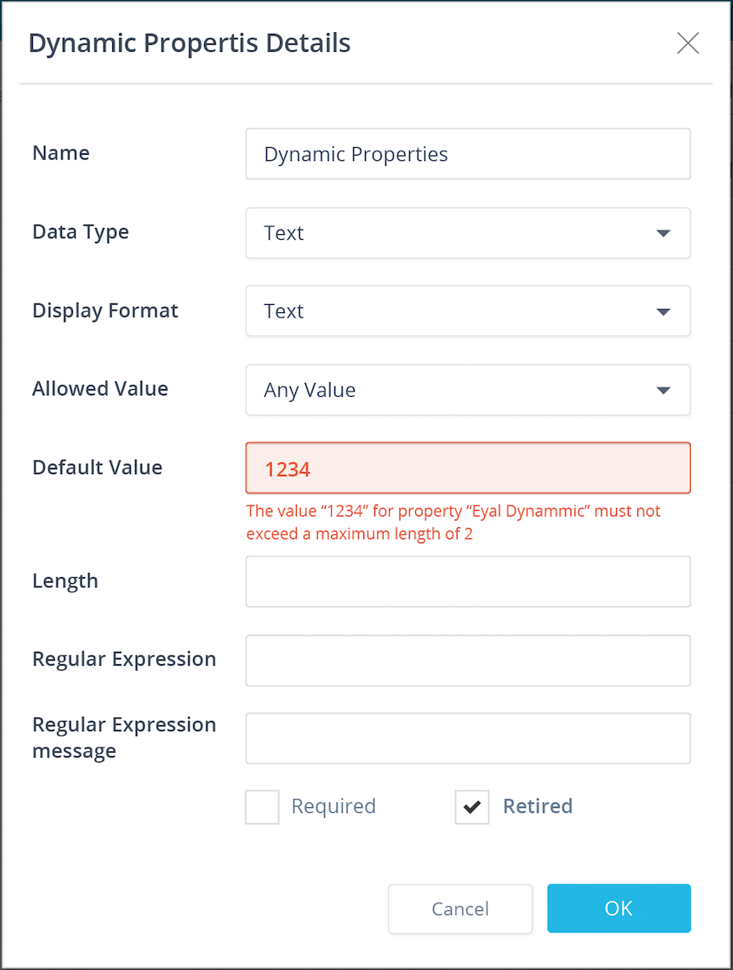
Admin > Settings > Custom properties > Decision View
Decision View
Add
Search a Decision View
✕
Order
Custom Properties
Data Type
Display Format
Allowed Value
Required
Retired
✕
1
2
3
4
Property A
Implementation Notes
Owner
Source
TEXT
TEXT
TEXT
TEXT
Text
Text
Text
Text
Any Value
Any Value

Slide 18
Admin > Settings > Custom properties > Decision View
Decision View
Add
Search a Decision View
✕
Order
Custom Properties
Data Type
Display Format
Allowed Value
Required
Retired
1
2
3
4
5
Property A
Implementation Notes
Owner
Source
Eyal Dynamic
TEXT
TEXT
TEXT
TEXT
TEXT
Text
Text
Text
Text
Text
Any Value
Any Value
New row added “in place” where it should appear when sorted by the default sorting
Added row is highlighted even if the cursor focus isn’t there

Slide 19
Admin > Settings > Custom properties > Decision View
Decision View
Add
Search a Decision View
✕
Order
Custom Properties
Data Type
Display Format
Allowed Value
Required
Retired
1
2
3
4
5
Property A
Implementation Notes
Owner
Source
Eyal Dynamic
TEXT
TEXT
TEXT
TEXT
TEXT
Text
Text
Text
Text
Text
Any Value
Any Value

Slide 20
Admin > Settings > Custom properties > Decision View
Decision View
Add
Search a Decision View
✕
Order
Custom Properties
Data Type
Display Format
Not to do now
Allowed Value
Required
Retired
1
2
3
4
5
Property A
Implementation Notes
Owner
Source
Eyal Dynamic
TEXT
TEXT
TEXT
TEXT
TEXT
Text
Text
Text
Text
Text
Any Value
Any Value
Drag element also has an over state

Slide 21

Search
23
John
⌃
Admin
Settings
Home > Settings > Custom Properties > Decision View
Not to do now
Decision View (4)
Manage the Dynamic Properties of each Custom Property
Add
Order
Custom Properties
Data Type
Display Format
Allowed Values
Required
Retired
1
Dynamic Properties
TEXT
Text
Any Value
5
Eyal Dynamic
TEXT
Text
Any Value
2
Implementation Notes
TEXT
Text
Any Value
3
Owner
TEXT
Text
Note the shadow while dragging
Note the feedback where the row will enter if dropped
4
Source
TEXT
Text

Slide 22
Search
23
John
⌃
Admin
Settings
Home > Settings > Custom Properties > Decision View
Not to do now
Decision View (4)
Manage the Dynamic Properties of each Custom Property
Add
Order
Custom Properties
Data Type
Display Format
Allowed Values
Required
Retired
1
Dynamic Properties
TEXT
Text
Any Value
2
Eyal Dynamic
TEXT
Text
Any Value
3
Implementation Notes
TEXT
Text
Any Value
4
Owner
TEXT
Text
When dropped, all rows are re-numbered
5
Source
TEXT
Text

Slide 23
Custom Properties
Data Type Formats
File Extensions
Format Definitions
Functions
Operators
Repository Definitions
Test Group Formats
Validation Rules
Verbs
System Options
Data Type Formats

Slide 24
Admin > Settings > Data Type Formats
Data Type Formats
Add
Search a Data Type
✕
⌃
Data Type
Default Format
Example
AMOUNT
CODE
DATE
DATE_TIME
IDENTIFIER
INDICATOR
NAME
NUMERIC
PERCENT
Currency USD
$ 65,432.10
Text
Hello!
Date Short US
1/25/2016
Date Long Time US
Saturday, January 25, 2016 1:23 PM
Text
Hello!
Text
Hello!
Text
Hello!
Decimal
12345.678
Text
Hello!

Slide 25
Admin > Settings > Data Type Formats > Date Time
Data Time
Add
Search a Date Time
✕
⌃
Name
Example
Default
Status
US Date Long Time
US Date Short Time
EU Date Long Time
EU Date Short Time
Saturday, January 25, 2016 1:23 PM
Enabled
Disabled
Enabled
Enabled
1/25/2016 1:23 PM
Default
Saturday, January 25, 2016 13:23
1/25/2016 13:23
Make Default
Disable
✕
Hovering the row displays the action buttons that do not appear otherwise – in this case it’s the “Make Default” button
Hovering the row displays the action buttons that do not appear otherwise – in this case it’s the “Disable” button
Remove
removes internally the primitive display format name related to that data type (if it is not used elsewhere)

Slide 26
Admin > Settings > Data Type Formats > Date Time
Data Time
Add
Search a Date Time
✕
⌃
Name
Example
Default
Status
US Date Long Time
US Date Short Time
EU Date Long Time
EU Date Short Time
Saturday, January 25, 2016 1:23 PM
Enabled
Disabled
Enabled
Enabled
1/25/2016 1:23 PM
Default
Saturday, January 25, 2016 13:23
1/25/2016 13:23
Enabled

Slide 27
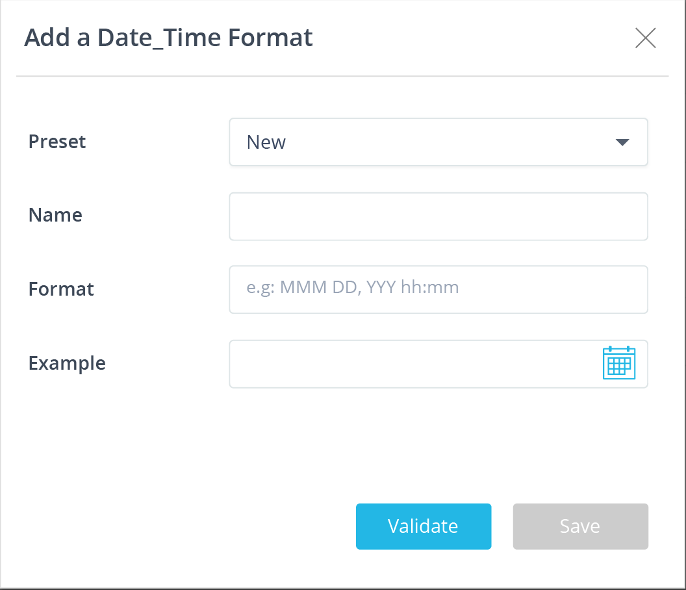
Add a Date_Time format
Using ‘ADD’ button
Without using the preset
Just type the name and format

Slide 28
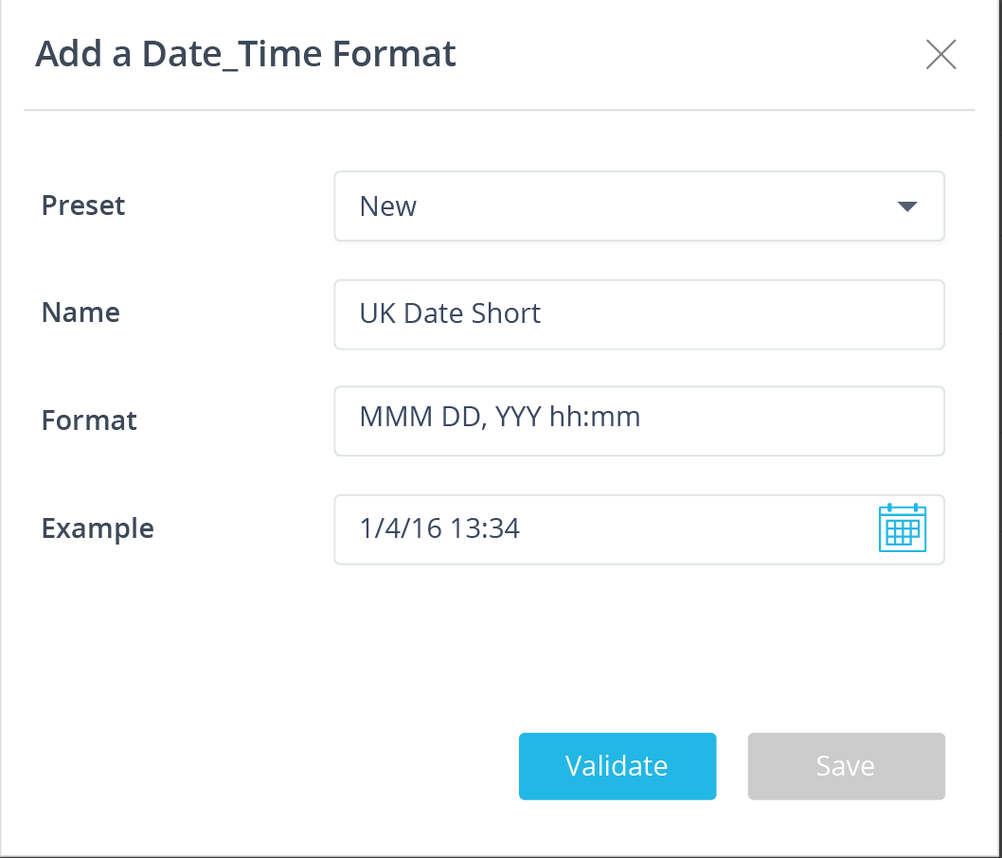
After typing the name and format choose your own example and then validate it

Slide 29
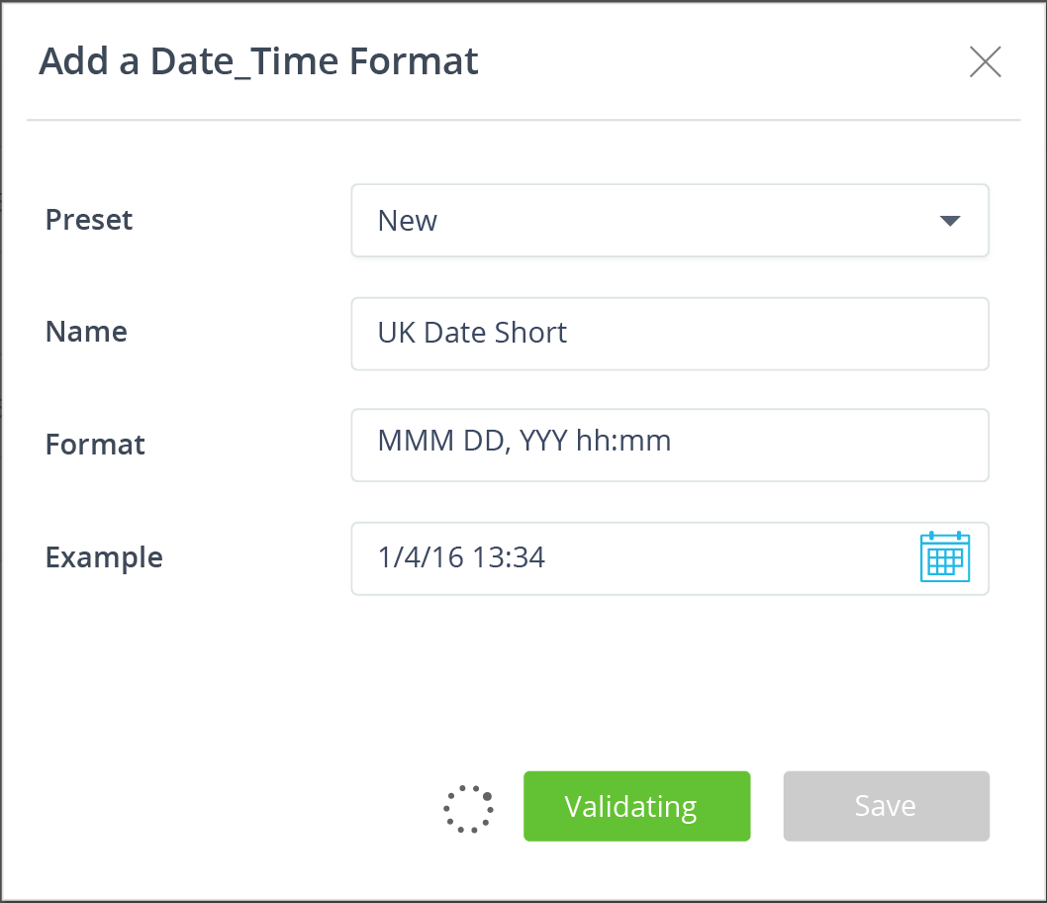
Validating

Slide 30
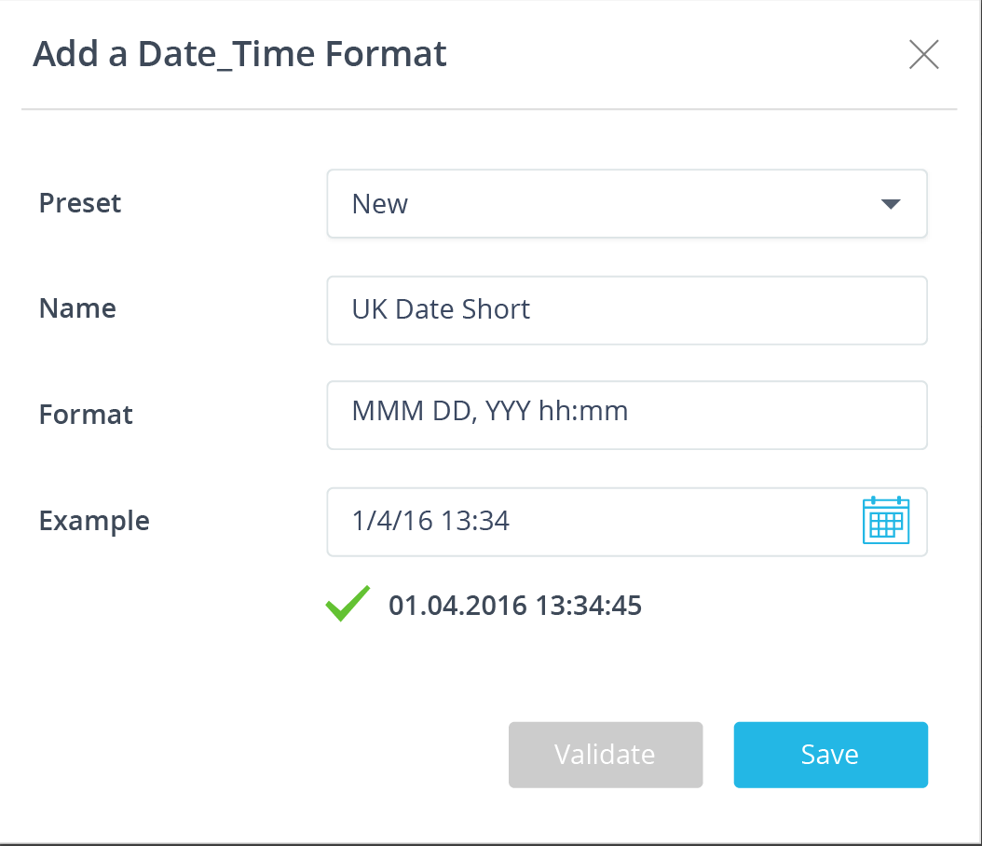

Add a Date_Time Format
✕
Preset
Name
Format
Example
New
After validating you can save
A new preset is created in the background
You can still validate other entries of data of your choice
⌃
UK Date Short
dd:MM:yyyy hh:mm:ss
1/4/16 13:34
✔
01.04.2016 13:34:45
Validate
Validate
Save

Slide 31
Create a new Date_Time format using a preset
Click the preset combo and choose one of the existing items
Only Date_Time formats are available
All fields get automatically filled
Add a Date_Time Format
✕
Preset
Name
Format
Example
New
⌃
Eg: EEEEEE, dd:MM:yyyy hh:mm:ss am
Validate
Save

Slide 32
The fields fill in automatically
You can use the same name or override it with a new name – which will create a new preset
Add a Date_Time Format
✕
Preset
Name
Format
Example
UK Long Format
⌃
UK Long Format
dd:MM:yyyy hh:mm:ss
01.04.2016 13:34:45
Validate
Save

Slide 33
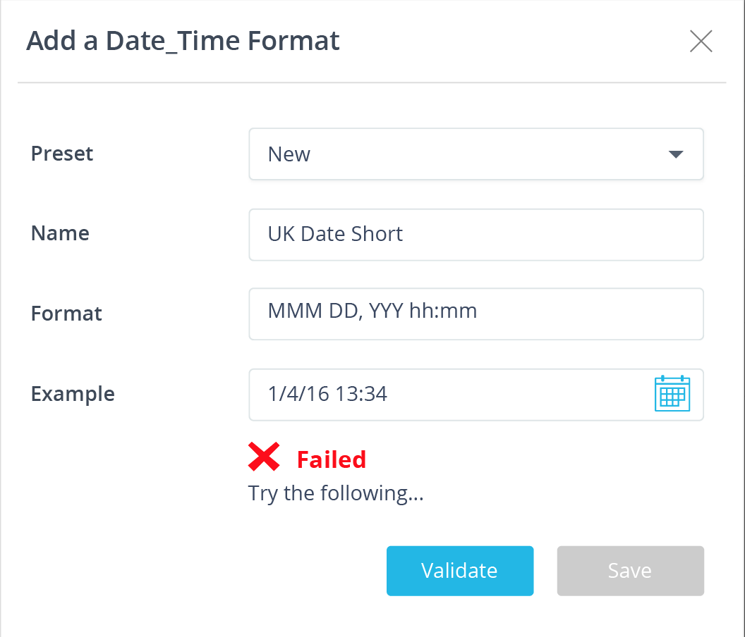
Failing invokes a message.
Make changes and validate again

Slide 34
Custom Properties
Data Type Formats
File Extensions
Format Definitions
Functions
Operators
Repository Definitions
Test Group Formats
Validation Rules
Verbs
System Options
File Extensions

Slide 35
Admin > Settings > File Extensions
File Extensions
Add
Search a File Extension
✕
⌃
Extension
Description
Max Size (Mb)
CSV
Doc
Docx
Log
PDF
PPT
PPTX
Properties
Comma Separated Value
Microsoft Word
Microsoft Word
Log Files
Portable Document Format
Microsoft PowerPoint
Microsoft PowerPoint
System Properties
10 Mb
10 Mb
10 Mb
1 Mb
10 Mb
10 Mb
10 Mb
10 Mb
Log
Log Files
1 Mb
Hovering the row highlights in white text items that are editable
Hovering on the text itself adds an outline to the field
When in ‘fill’ mode, all editable areas in the row appear with the outline

Slide 36
Admin > Settings > File Extensions
File Extensions
Add
Search a File Extension
Add
✕
✕
⌃
Extension
Description
Max Size (Mb)
CSV
Doc
Docx
Log
PDF
PPT
PPTX
Properties
Comma Separated Value
Microsoft Word
Microsoft Word
Log Files
Portable Document Format
Microsoft PowerPoint
Microsoft PowerPoint
System Properties
10 Mb
10 Mb
10 Mb
1 Mb
10 Mb
10 Mb
10 Mb
10 Mb

Slide 37
Admin > Settings > File Extensions
File Extensions
Add
Search a File Extension
✕
⌃
Extension
Description
Max Size (Mb)
XLSX
Microsoft Excel
10 Mb
CSV
Doc
Docx
Log
PDF
PPT
PPTX
Properties
Comma Separated Value
Microsoft Word
Microsoft Word
Log Files
Portable Document Format
Microsoft PowerPoint
Microsoft PowerPoint
System Properties
10 Mb
10 Mb
10 Mb
1 Mb
10 Mb
10 Mb
10 Mb
10 Mb
When in ‘fill’ mode, all editable areas in the row appear with the outline – even with no hover
To complete the update click outside or click the ‘Enter’ key

Slide 38
Admin > Settings > File Extensions
File Extensions
Add
Search a File Extension
✕
⌃
Extension
Description
Max Size (Mb)
CSV
Doc
Docx
XLSX
Log
PDF
PPT
PPTX
Properties
Comma Separated Value
Microsoft Word
Microsoft Word
Microsoft Excel
Log Files
Portable Document Format
Microsoft PowerPoint
Microsoft PowerPoint
System Properties
10 Mb
10 Mb
10 Mb
10 Mb
1 Mb
10 Mb
10 Mb
10 Mb
10 Mb
New row added in place and is highlighted

Slide 39
Custom Properties
Data Type Formats
File Extensions
Format Definitions
Functions
Operators
Repository Definitions
Test Group Formats
Validation Rules
Verbs
System Options
Format Definitions

Slide 40
Admin > Settings > Format Definitions
Format Definitions
Search a Definition
⌃
⌃
Format Definition
Properties
Status
Version*
BDES
Enabled
Disabled
Enabled
Enabled
CSV minimal export
Include Manifest*
Include Release Information*
Export Contents*
CSV modular export
Include Manifest*
Include Release Information*
Export Contents*
Note how all status text is in the same column
Decision Drools File
Support Drools 5.3*
Support Guvnor by specifying dialect for each rule*
Dialect*
Drools File Template*
ShouldDriPackageNameContainTagName*
DecisionInputBeanGeneratorName*
Include Manifest*
JavaInputBean JDK version*

Slide 41
Admin > Settings > Format Definitions
Format Definitions
Search a Definition
⌃
⌃
Format Definition
Properties
Status
BDES
Version*
Enabled
Disabled
Enabled
Enabled
Disable
Retire
Deprecate
✕
CSV minimal export
Include Manifest*
Include Release Information*
Export Contents*
On hover, all the edit options appear – here the 3 buttons to disable, retire and deprecate the item
CSV modular export
Include Manifest*
Include Release Information*
Export Contents*
Decision Drools File
Support Drools 5.3*
Support Guvnor by specifying dialect for each rule*
Dialect*
Drools File Template*
ShouldDriPackageNameContainTagName*
DecisionInputBeanGeneratorName*
Include Manifest*
JavaInputBean JDK version*

Slide 42
Custom Properties
Data Type Formats
File Extensions
Format Definitions
Functions
Operators
Repository Definitions
Test Group Formats
Validation Rules
Verbs
System Options
Functions

Slide 43
Admin > Settings > Functions
Functions
Add
Search a Function
✕
⌃
Function
Description
Status
ABS(num):NUMERIC
AVERAGE(num1,num2,num3…):NUMERIC List
CONCATENATE(text1,text2,text3…):TEXT
COUNT(num1,num2,num3…):NUMERIC List
DAY_ADD(date,day to add):DATE
DAY(date):NUMERIC
DAY_DIFF(date1,date2):NUMERIC
Returns the absolute value of a number
Returns the average of the values within a given list of Fact Types and/or values
Returns the Concatenation of the given list of text values
Enabled
Enabled
Enabled
Enabled
Disabled
Enabled
Enabled
Returns the count of the values within a given list of Fact Types, or a list of Fact Types and/or values. This is a demonstration of a very very very long description. This is a demonstration of a very very very long description. This is a demonstration of a very very very long description
Returns the absolute value of a number
Returns the average of the values within a given list of Fact Types and/or values
Returns the Concatenation of the given list of text values

Slide 44
Admin > Settings > Functions
Functions
Add
Search a Function
✕
⌃
Function
Description
Status
ABS(num):NUMERIC
AVERAGE(num1,num2,num3…):NUMERIC List
CONCATENATE(text1,text2,text3…):TEXT
COUNT(num1,num2,num3…):NUMERIC List
DAY_ADD(date,day to add):DATE
DAY(date):NUMERIC
DAY_DIFF(date1,date2):NUMERIC
Returns the absolute value of a number
Returns the average of the values within a given list of Fact Types and/or values
Returns the Concatenation of the given list of text values
Enabled
Enabled
Enabled
Enabled
Disabled
Enabled
Enabled
Disable
✕
Returns the count of the values within a given list of Fact Types, or a list of Fact Types and/or values. This is a demonstration of a very very very long description. This is a demonstration of a very very very long description. This is a demonstration of a very very very long description
Returns the absolute value of a number
Returns the average of the values within a given list of Fact Types and/or values
Returns the Concatenation of the given list of text values

Slide 45
Admin > Settings > Functions
Functions
Add
Search a Function
✕
⌃
Function
Description
Status
ABS(num):NUMERIC
AVERAGE(num1,num2,num3…):NUMERIC List
CONCATENATE(text1,text2,text3…):TEXT
COUNT(num1,num2,num3…):NUMERIC List
DAY_ADD(date,day to add):DATE
DAY(date):NUMERIC
DAY_DIFF(date1,date2):NUMERIC
Returns the absolute value of a number
Returns the average of the values within a given list of Fact Types and/or values
Returns the Concatenation of the given list of text values
Enabled
Enabled
Enabled
Enabled
Disabled
Enabled
Enabled
Disable
✕
Returns the count of the values within a given list of Fact Types, or a list of Fact Types and/or values. This is a demonstration of a very very very long description. This is a demonstration of a very very very long description. This is a demonstration of a very very very long description
Returns the absolute value of a number
Returns the average of the values within a given list of Fact Types and/or values
Returns the Concatenation of the given list of text values

Slide 46
Admin > Settings > Functions
Functions
Add
Search a Function
✕
⌃
Function
Description
Status
ABS(num):NUMERIC
AVERAGE(num1,num2,num3…):NUMERIC List
CONCATENATE(text1,text2,text3…):TEXT
COUNT(num1,num2,num3…):NUMERIC List
DAY_ADD(date,day to add):DATE
DAY(date):NUMERIC
DAY_DIFF(date1,date2):NUMERIC
Returns the absolute value of a number
Returns the average of the values within a given list of Fact Types and/or values
Returns the Concatenation of the given list of text values
Enabled
Disabled
Enabled
Enabled
Disabled
Enabled
Enabled
✕
Returns the count of the values within a given list of Fact Types, or a list of Fact Types and/or values. This is a demonstration of a very very very long description. This is a demonstration of a very very very long description. This is a demonstration of a very very very long description
Returns the absolute value of a number
Returns the average of the values within a given list of Fact Types and/or values
Returns the Concatenation of the given list of text values

Slide 47


Admin > Settings > Functions
Function Properties
✕
Functions
Add
Search a Function
✕
Name
AVERAGE
⌃
Function
Description
Status
Description
Returns the average of the values within a given list of Fact Types and/or values
ABS(num):NUMERIC
AVERAGE(num1,num2,num3…):NUMERIC
CONCATENATE(text1,text2,text3…):TEXT
COUNT(num1,num2,num3…):NUMERIC
DAY_ADD(date,day to add):DATE
DAY(date):NUMERIC
DAY_DIFF(date1,date2):NUMERIC
Returns the absolute value of a number
Returns the average of the values within a given list of Fact Types and/or values
Returns the Concatenation of the given list of text values
Enabled
Enabled
Enabled
Enabled
Enabled
Enabled
Disabled
Return Type
⌃
NUMERIC
List
Enabled
Name
Type
Infinite
List
Returns the count of the values within a given list of Fact Types, or a list of Fact Types and/or values. This is a demonstration of a very very very long description. This is a demonstration of a very very very long description. This is a demonstration of a very very very long description
Parameters
num1,num2,num3…
NUMERIC
Infinite
List
Add
✕
Returns the absolute value of a number
Returns the average of the values within a given list of Fact Types and/or values
Returns the Concatenation of the given list of text values
Cancel
OK

Slide 48
Admin > Settings > Functions
Function Properties
✕
Function Properties
✕
Functions
Add
Search a Function
✕
Name
AVERAGE
Name
AVERAGE
⌃
Function
Description
Status
Description
Returns the average of the values within a given list of Fact Types and/or values
Description
Returns the average of the values within a given list of Fact Types and/or values
ABS(num):NUMERIC
AVERAGE(num1,num2,num3…):NUMERIC
CONCATENATE(text1,text2,text3…):TEXT
COUNT(num1,num2,num3…):NUMERIC
DAY_ADD(date,day to add):DATE
DAY(date):NUMERIC
DAY_DIFF(date1,date2):NUMERIC
Returns the absolute value of a number
Returns the average of the values within a given list of Fact Types and/or values
Returns the Concatenation of the given list of text values
Enabled
Enabled
Enabled
Enabled
Enabled
Enabled
Disabled
Return Type
⌃
Return Type
⌃
NUMERIC
NUMERIC
List
Enabled
List
Enabled
Name
Type
Infinite
List
Name
Type
Infinite
List
✕
✕
Returns the count of the values within a given list of Fact Types, or a list of Fact Types and/or values. This is a demonstration of a very very very long description. This is a demonstration of a very very very long description. This is a demonstration of a very very very long description
value1
value1
num1,num2,num3…
num1,num2,num3…
Parameters
num1,num2,num3…
NUMERIC
Infinite
List
Parameters
num1,num2,num3…
⌃
NUMERIC
Infinite
List
NUMERIC
Infinite
List
NUMERIC
Infinite
List
Add
Add
✕
✕
Returns the absolute value of a number
Returns the average of the values within a given list of Fact Types and/or values
Returns the Concatenation of the given list of text values
Cancel
OK
Cancel
OK
When Hovering a row all editable fields get the white bkg and the [X} lets you remove the row
When the focus is on one field, it becomes editable and ‘gets’ its editing widgets: combo list (NUMERIC) and checkbox in Infinite and List.

Slide 49
Custom Properties
Data Type Formats
File Extensions
Format Definitions
Functions
Operators
Repository Definitions
Test Group Formats
Validation Rules
Verbs
System Options
Operators
Lists Operators with the ability to designate for which Data Types the Operators are allowed.
For each operator allows the setting of the Operator Name, Symbol and Inclusion Type
In reality only the Symbol should be allowed to be changed by an end-user
The Data Types for each operator its name and Inclusion Type should really be set for the system and not editable by end clients.

Slide 50
Admin > Settings > Operators
Operators
Search an Operator
⌃
Function
Symbol
Inclusion
Data types
Contains
~
Inclusive
Indicator
List
Name
Text
Contains Any
containsany
Inclusive
Indicator
List
Name
Text
Contains Any (IC)
containsanyignorecase
Inclusive
Note how all data types appear without the remove element – until hovering the row
Does Not Contain
!~
Exclusive
Indicator
List
Name
Text
Does Not Contain Any
doesnotcontainany
Exclusive
Indicator
List
Name
Text
Does Not Contain Any (IC)
doesnotcontainanyignorecase
Exclusive
Does Not Contain (IC)
doesnotcontainignorecase
Exclusive
Is
is
Inclusive
Amount
Basis_Points
Code
Conclusion
Date
Day
Identifier
Indicator
Month
Month_Year
Name
Numeric
Percent
Quantity
Text
Year
Is After the Date
>
Inclusive
Date
Is After the Time
>
Inclusive
Date_Time

Slide 51
Admin > Settings > Operators
Operators
Search an Operator
⌃
Function
Symbol
Inclusion
Data types
Contains
~
Inclusive
Indicator
List
Name
Text
Contains Any
containsany
Inclusive
Indicator ✕
List ✕
Name ✕
Text ✕
+
Contains Any (IC)
containsanyignorecase
Inclusive
Hover reveals the remove option for the data types and adds the [+] button that lets users add a data type
Does Not Contain
!~
Exclusive
Indicator
List
Name
Text
Does Not Contain Any
doesnotcontainany
Exclusive
Indicator
List
Name
Text
Does Not Contain Any (IC)
doesnotcontainanyignorecase
Exclusive
Does Not Contain (IC)
doesnotcontainignorecase
Exclusive
Is
is
Inclusive
Amount
Basis_Points
Code
Conclusion
Date
Day
Identifier
Indicator
Month
Month_Year
Name
Numeric
Percent
Quantity
Text
Year
Is After the Date
>
Inclusive
Date
Is After the Time
>
Inclusive
Date_Time

Slide 52
Admin > Settings > Operators
Operators
Search an Operator
⌃
Function
Symbol
Inclusion
Data types
Contains
~
Inclusive
Indicator
List
Name
Text
Contains Any
containsany
Inclusive
Indicator ✕
List ✕
Name ✕
Text ✕
+
Contains Any (IC)
containsanyignorecase
Inclusive
Does Not Contain
!~
Exclusive
Indicator
List
Name
Text
Does Not Contain Any
doesnotcontainany
Exclusive
Indicator
List
Name
Text
Does Not Contain Any (IC)
doesnotcontainanyignorecase
Exclusive
Does Not Contain (IC)
doesnotcontainignorecase
Exclusive
Is
is
Inclusive
Amount
Basis_Points
Code
Conclusion
Date
Day
Identifier
Indicator
Month
Month_Year
Name
Numeric
Percent
Quantity
Text
Year
Is After the Date
>
Inclusive
Date
Is After the Time
>
Inclusive
Date_Time

Slide 53
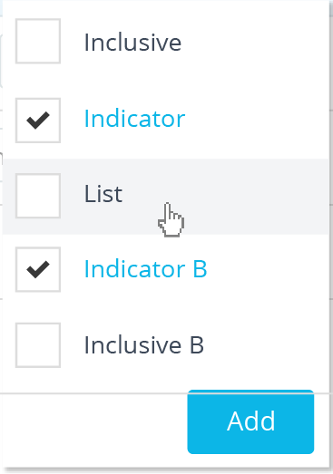
Admin > Settings > Operators
Operators
Search an Operator
⌃
Function
Symbol
Inclusion
Data types
Can add multiple data types in one go
Contains
~
Inclusive
Indicator
List
Name
Text
Contains Any
containsany
Inclusive
Indicator ✕
List ✕
Name ✕
Text ✕
+
Contains Any (IC)
containsanyignorecase
Inclusive
Does Not Contain
!~
Exclusive
Indicator
List
Name
Text
Does Not Contain Any
doesnotcontainany
Exclusive
Indicator
List
Name
Text
Does Not Contain Any (IC)
doesnotcontainanyignorecase
Exclusive
Does Not Contain (IC)
doesnotcontainignorecase
Exclusive
Is
is
Inclusive
Amount
Basis_Points
Code
Conclusion
Date
Day
Identifier
Indicator
Month
Month_Year
Name
Numeric
Percent
Quantity
Text
Year
Is After the Date
>
Inclusive
Date
Is After the Time
>
Inclusive
Date_Time

Slide 54
Custom Properties
Data Type Formats
File Extensions
Format Definitions
Functions
Operators
Repository Definitions
Test Group Formats
Validation Rules
Verbs
System Options
Repository Definitions

Slide 55
Admin > Settings > Repository Definitions
Repository Definitions
Search a Definition
⌃
Repository Definition
Properties
Status
BDES (Business Decision Executive Server)
- DeploymentUserName*
- DeploymentUserPassword*
- RepositoryUrl*
- Deployment Registration*
Enabled
Disabled
Enabled
Nexus
- Artifact Group ID*
- Nexus Username*
- Snapshots Repository ID*
- Nexus Password*
- Nexus URL*
- Release Repository ID*
- Deployment Registration*
Script Based Deployer
- Script Type*
- Script File Path*
- Script Property File Path*
- Deployment Registration*

Slide 56
Admin > Settings > Repository Definitions
Repository Definitions
Search a Definition
⌃
Repository Definition
Properties
Status
BDES (Business Decision Executive Server)
- DeploymentUserName*
- DeploymentUserPassword*
- RepositoryUrl*
- Deployment Registration*
✕
Enabled
Disabled
Enabled
Disable
Retire
Deprecate
Nexus
- Artifact Group ID*
- Nexus Username*
- Snapshots Repository ID*
- Nexus Password*
- Nexus URL*
- Release Repository ID*
- Deployment Registration*
Script Based Deployer
- Script Type*
- Script File Path*
- Script Property File Path*
- Deployment Registration*

Slide 57
Custom Properties
Data Type Formats
File Extensions
Format Definitions
Functions
Operators
Repository Definitions
Test Group Formats
Validation Rules
Verbs
System Options
Test Group Formats

Slide 58
Admin > Settings > Text Group Formats
Test Groups Formats
Search a Format
⌃
Format Definition
Properties
Status
CSV
- Test Groups to Export*
Enabled
Disabled
XML
- Test Groups to Export*

Slide 59
Admin > Settings > Text Group Formats
Test Groups Formats
Search a Format
⌃
Format Definition
Properties
Status
CSV
- Test Groups to Export*
Enabled
Disabled
XML
- Test Groups to Export*
Enable
Retire
Deprecate
✕

Slide 60
Custom Properties
Data Type Formats
File Extensions
Format Definitions
Functions
Operators
Repository Definitions
Test Group Formats
Validation Rules
Verbs
System Options
Validation Rules

Slide 61
Admin > Settings > Validation Rules
Validation Rules
Search a Rule
Principle
⌃
Severity
Name
P4
P3
P5
P12
P4
P2
P5
P3
Row must have a body
Error
Operand {0} is not valid. Operator {1} requires the operand to contain 2 values
Warning
The conclusion Fact Type may not be used as a Condition Fact Type
Warning
The same set of conditions cannot result in different conclusions
Error
Duplicate row
Error
Rule Family View is required to have a heading
Error
Rule Family View is required to have a conclusion
Error
Decision View contains an orphan Rule Family View {0}
Error

Slide 62
Admin > Settings > Validation Rules
Validation Rules
Search a Rule
Principle
⌃
Severity
Name
P4
P3
P5
P12
P4
P2
P5
P3
Row must have a body
Error
Operand {0} is not valid. Operator {1} requires the operand to contain 2 values
Warning
Error
✕
The conclusion Fact Type may not be used as a Condition Fact Type
Warning
The same set of conditions cannot result in different conclusions
Error
Duplicate row
Error
Rule Family View is required to have a heading
Error
Rule Family View is required to have a conclusion
Error
Decision View contains an orphan Rule Family View {0}
Error

Slide 63
Custom Properties
Data Type Formats
File Extensions
Format Definitions
Functions
Operators
Repository Definitions
Test Group Formats
Validation Rules
Verbs
System Options
Add
Edit
Remove
Sort By Name Asc
Ability to Sort on column
Add button is OK
On Add Button creates empty row on top of screen
Can Enter the value and enter or click off will save like the Grid Control
Hover on Row to delete
Delete confirmation required
Single click on cell will enable the row for edit and can edit and tab to next cells
Enter or click of row will save
ESC is a cancel
Confirmation message that disappears when item added
Verbs

Slide 64
Admin > Settings > Verbs
Verbs
Add
Search a Verb
✕
⌃
Name
Assess
Calculate
Determine
Estimate
Validate
Kill

Slide 65
Admin > Settings > Verbs
Verbs
Add
Search a Verb
✕
⌃
Name
Assess
Calculate
Determine
Estimate
Validate
Kill
Calculate
✕

Slide 66
Admin > Settings > Verbs
Verbs
Add
Search a Verb
✕
⌃
Name
Assess
Calculate
Determine
Estimate
Validate
Kill
Calculate
✕

Slide 67
Admin > Settings > Verbs
Verbs
Add
Search a Verb
✕
⌃
Name
Assess
Calculate
Determine
Estimate
Validate
Kill
Calculate Edited
✕

Slide 68
Admin > Settings > Verbs
Verb was updated UNDO
Verbs
Add
Search a Verb
✕
⌃
Name
Note how the undo option is displayed
Assess
Calculate Edited
Determine
Estimate
Validate
Kill
Not to do now

Slide 69
Custom Properties
Data Type Formats
File Extensions
Format Definitions
Functions
Operators
Repository Definitions
Test Group Formats
Validation Rules
Verbs
System Options
System Options

Slide 70
Admin > Settings > System Options
System Options
Search a System Option
⌃
Name
Description
Value
Decision graph column spacing
Indicates the graph column spacing
Indicates the graph direction
Select this option to cause Rule Family Views to appear in expanded/collapsed display format. In this view,
click the plus/ minus sign to expand/ collapse the Rule Family View
Specifies the number of Rules Family Views in a display which if exceeded will cause the Rule Family Views
to appear collapsed
Indicates the graph layer spacing
Indicates the graph maximum decision width shape
Indicates the graph maximum shape width
Indicates the graph minimum decision width shape
Indicates the graph minimum shape width
25
Decision graph direction
90
Decision graph expansion
Decision graph extension threshold
4
Decision graph layer spacing
20
Decision graph max decision shape width
160
Decision graph max shape width
300
Decision graph min decision shape width
30
Decision graph min shape width
30

Slide 71
Admin > Settings > System Options
System Options
Search a System Option
⌃
Name
Description
Value
Decision graph column spacing
Indicates the graph column spacing
Indicates the graph direction
Select this option to cause Rule Family Views to appear in expanded/collapsed display format. In this view,
click the plus/ minus sign to expand/ collapse the Rule Family View
Specifies the number of Rules Family Views in a display which if exceeded will cause the Rule Family Views
to appear collapsed
Indicates the graph layer spacing
Indicates the graph maximum decision width shape
Indicates the graph maximum shape width
Indicates the graph minimum decision width shape
Indicates the graph minimum shape width
25
Decision graph direction
90
Decision graph expansion
Decision graph extension threshold
4
Decision graph layer spacing
20
Decision graph max decision shape width
160
Decision graph max shape width
300
Decision graph min decision shape width
30
Decision graph min shape width
30

